Slide 1
Alternate Valuation Product Suite
Class Valuation

Slide 2
Products
AVM Automated Valuation Model | Fast and reliable: Obtain fast and accurate property valuations using advanced algorithms leveraging extensive data sources for reliable and precise valuations.
BPO (Broker Price Opinion) Agent property inspection with a value included | Benefit from expert insights: Gain in-depth property value analysis from experienced brokers.
AVM + PCR Automated Valuation Model + Property Condition Report | Fast, accurate, and insightful: Get quick and reliable AVM results combined with a detailed property condition report to ensure credibility.
Class Evaluation Analyst assisted AVM | Technology meets experience: Combine the power of analyst-assisted AVM with an interior or exterior inspection for a comprehensive valuation.
Limited Desktop PCR + Appraiser limited desktop analysis with valuation included | Unmatched precision: Get the most accurate valuations through a true appraisal using sophisticated quantitative methods and diverse data sources. (Borrower Attestation, PCRs, Disaster Certs, Final inspections)
Borrower Led Inspection Self-guided property documentation process | Convenient and efficient: Enable borrowers to complete required property inspections remotely through a customizable digital form, eliminating the need for third-party site visits.
CVA (Class Valuation Analysis) Comprehensive appraisal review by licensed appraisers | Expert verification and assurance: Receive comprehensive appraisal reviews conducted by state-licensed appraisers who evaluate the supporting data and methodologies to ensure valuation accuracy and compliance.

Slide 3
Class Valuation Alt. Product Fees
Alternative Product | Fee
AVM | $15
AVM + Property Condition Report - Exterior | $75
AVM + Property Condition Report - Interior | $85
Property Condition Report - Exterior | $60
Property Condition Report - Interior | $85
Borrower Led Inspection | $65
Broker Price Opinion - Exterior | $105
Broker Price Opinion - Interior | $140
Broker Price Opinion - Land | $105
Disaster Inspection - Exterior | $75
Alternative Product | Fee
Disaster Inspection - Interior | $125
Class Evaluation | $95
Class Evaluation - PCR Exterior | $135
Class Evaluation - PCR Interior | $175
Limited Desktop | $125
Limited Desktop - PCR Exterior | $175
Limited Desktop - PCR Interior | $230
Class Valuation Analysis (CVA) | $145 *Subject to change based on volume
Notes:
65

Slide 4
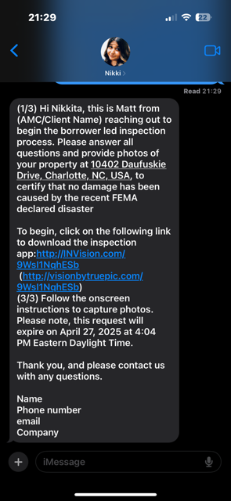
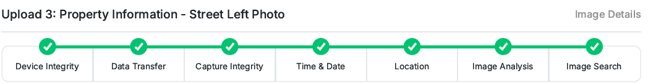
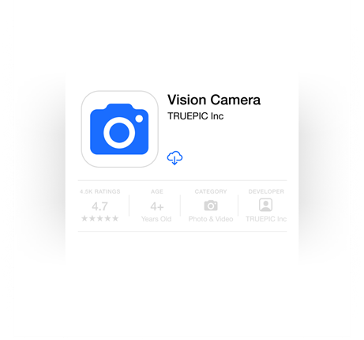
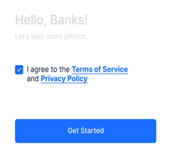
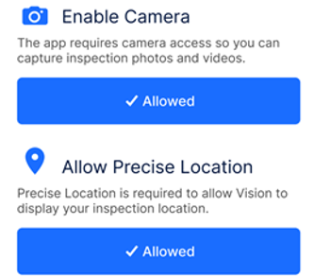
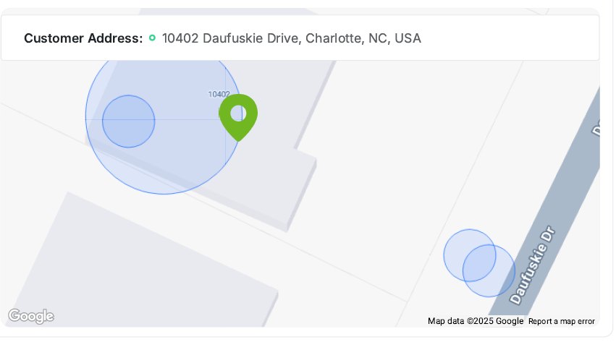
Borrower Led Inspection Explanation
  Fast, reliable, customizable
    Forms are 100% configurable & flexible to fit client requirements
    Message to customer can be altered & customized
    Includes geolocation & photo timestamps
    35 fraud detection tests & reverse image searches are conducted to verify images.
    Inspection audit trail included in report.
    Process is easy to follow, the app walks the customer through the steps to answer all required questions & provide specific photos needed to suffice lender requirements
    Class QC team will review all reports prior to delivery to client
Customer receives text to
initiate inspection
Customer clicks link & downloads app
Customer Agrees to terms & privacy policy and allows access to their camera & location
As each photo is taken, fraud checks on images & location verification is tracked within the report

Slide 5
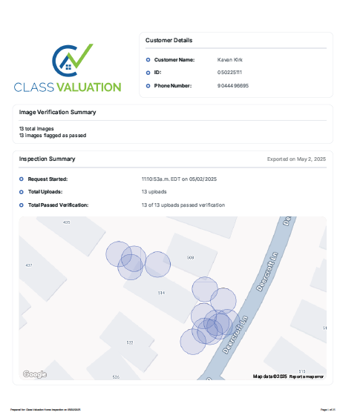
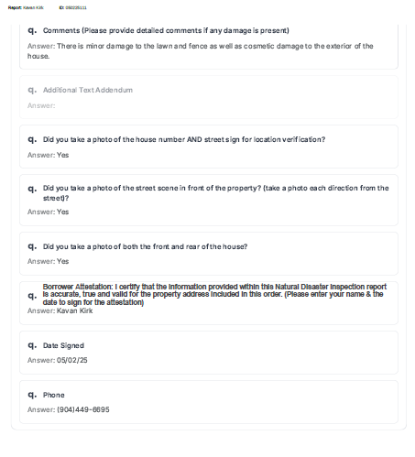
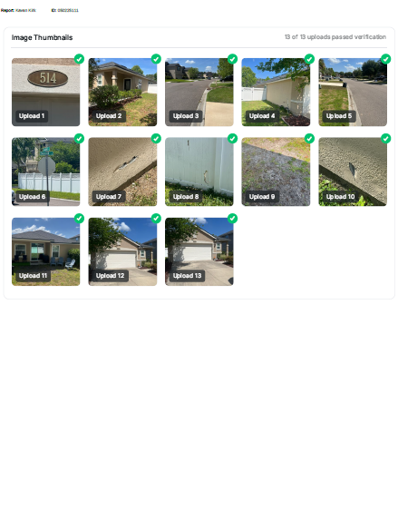
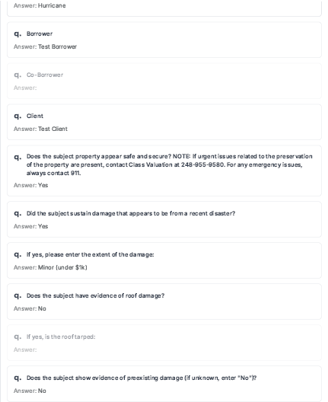
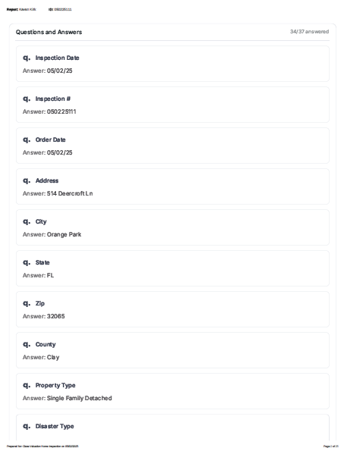
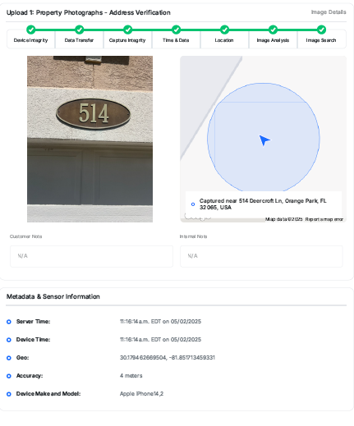
Borrower Led Inspection Example

Slide 6
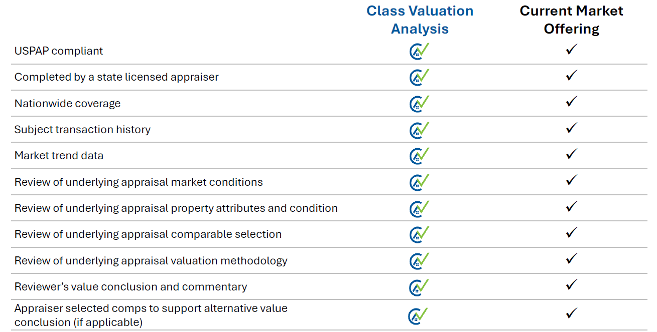
Class Valuation Analysis Explanation
Streamlined Desktop Assessment: appraisal review product designed for bulk portfolio valuations, loan production quality control, and the assessment of existing appraisals.
Class Valuation Analysis (CVA): A solution designed by Class to provide lenders with an alternative to the ClearCapital CDA.
Rating Agency Recognition: Lenders and Servicers have a strong desired to use our CVA, but they request that it be recognized or approved as an accepted review product by rating agencies.
Contents of Report:
  Graded risk score of appraisal under review
  Review of original appraisal’s content & conclusions
  Comp Grid
  Value Analysis
  Additional Appraiser-Selected Comps
  Value Commentary
  USPAP Compliant & Valuation quality questionnaire
  USPAP Compliant Appraiser signature section

Slide 7
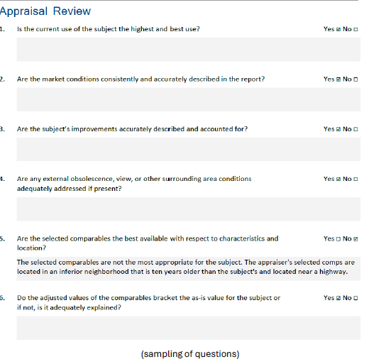
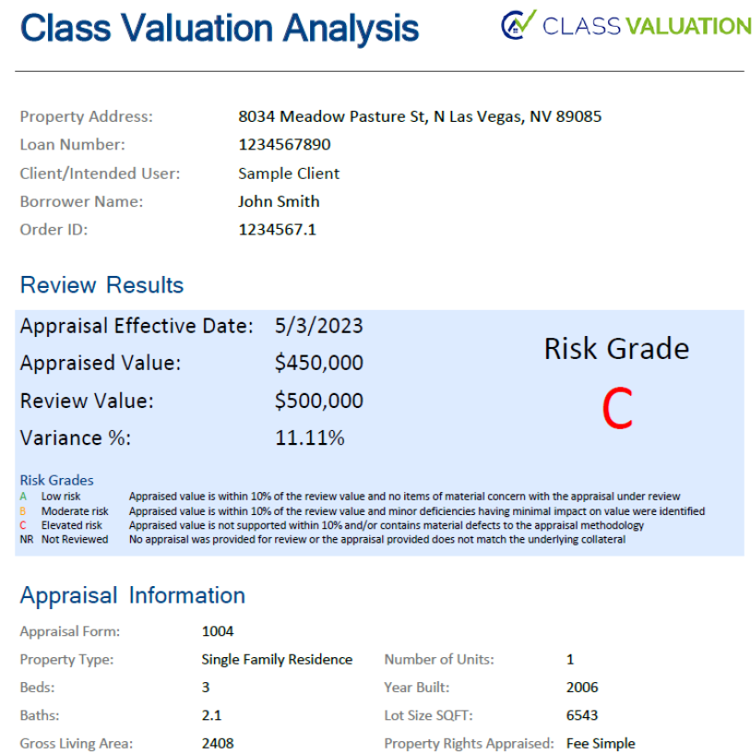
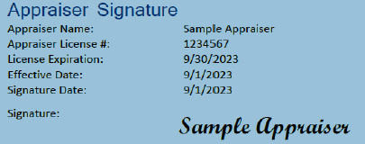
Class Valuation Analysis (CVA) Example
Graded Risk Scoring of Previous Appraised Value
Review Of Previous Appraisal Content and Conclusions

Slide 8
Alt. Valuation Standard Product Cascade
Can cascade from AVM to Class Evaluation if PCR is not required (Lender preference)
AVM
Confidence Score + Value
AVM Confidence Score acceptable
AVM + PCR
AVM + Inspection report
(Interior or Exterior)
No PCR Needed
Lender Decision
Class Evaluation
Analyst Assisted AVM
Fail
Report Delivered
No Reconciliation Needed
Confidence Score Increased
Limited Desktop
Traditional Appraisal
Report Accepted
Report Delivered
Report Delivery
Hybrid Appraisal
Report Delivered
Report Delivery

Slide 9
Alternative Valuation Standard Cascade
AVM
($15)
Upgrade Fee to AVM
+ PCR Ext = $60
Upgrade Fee to AVM + PCR Int = $75
AVM + Property Condition Report
(Exterior)
AVM + Property Condition Report
(Interior)
Upgrade Fee from AVM + PCR Ext to Class Eval = $70
Upgrade Fee from AVM + PCR Int to Class Eval + $85
Class Evaluation
Upgrade Fee = $125
Limited Desktop
Upgrade Fee + $125

Slide 10
Alternative Valuation Borrower Led Inspection Cascade
Borrower Led Inspection
($65)
Upgrade Fee to include AVM= $15
Upgrade Fee to include AVM= $15
Borrower Led Inspection + AVM
($80)
Upgrade Fee from BLI to Limited Class Evaluation = $75
Upgrade Fee from BLI to Full Class Eval = $95
Limited Class Evaluation
Full Class Evaluation
Upgrade Fee = $125
Limited Desktop
Upgrade Fee = $125

Slide 11
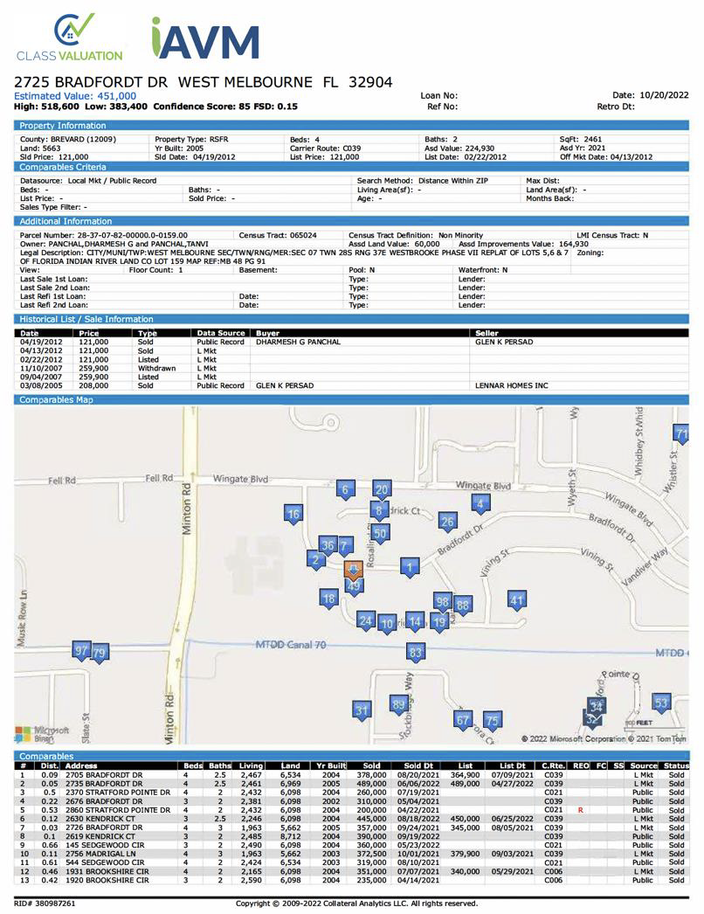
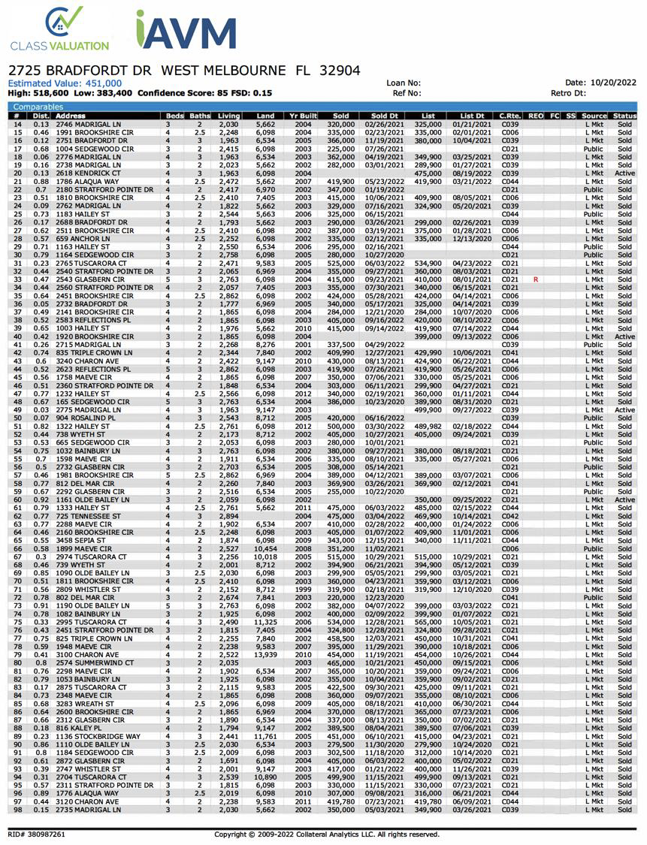
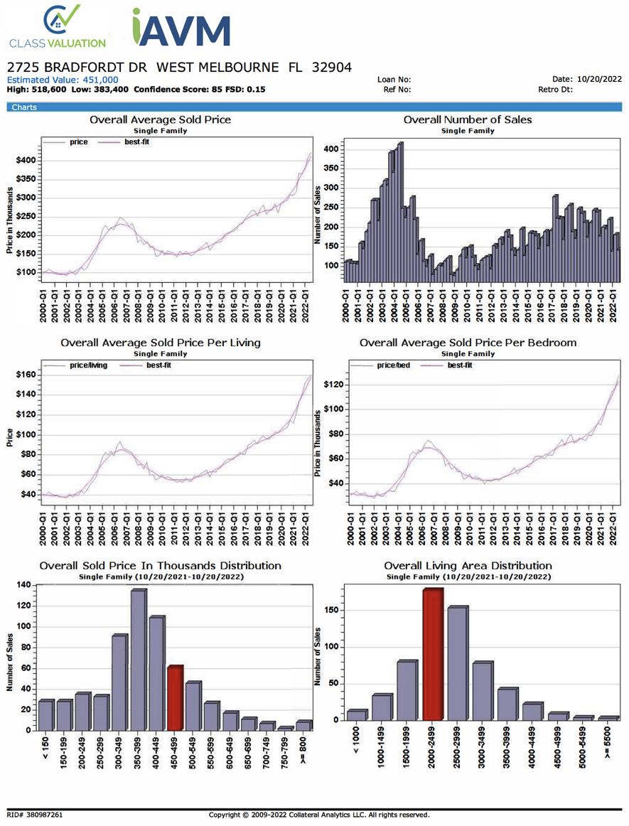
AVM Example

Slide 12
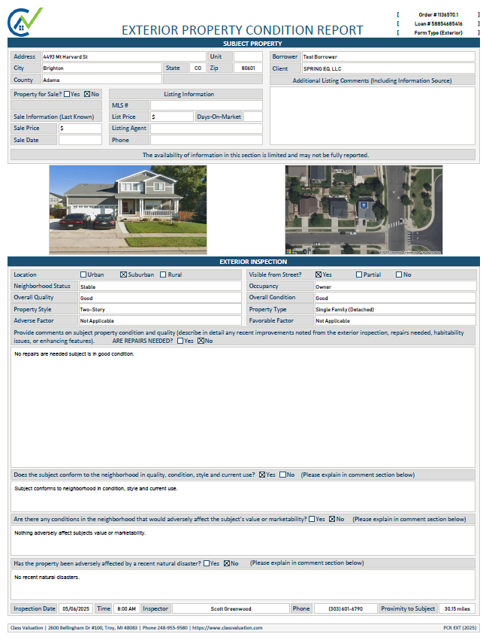
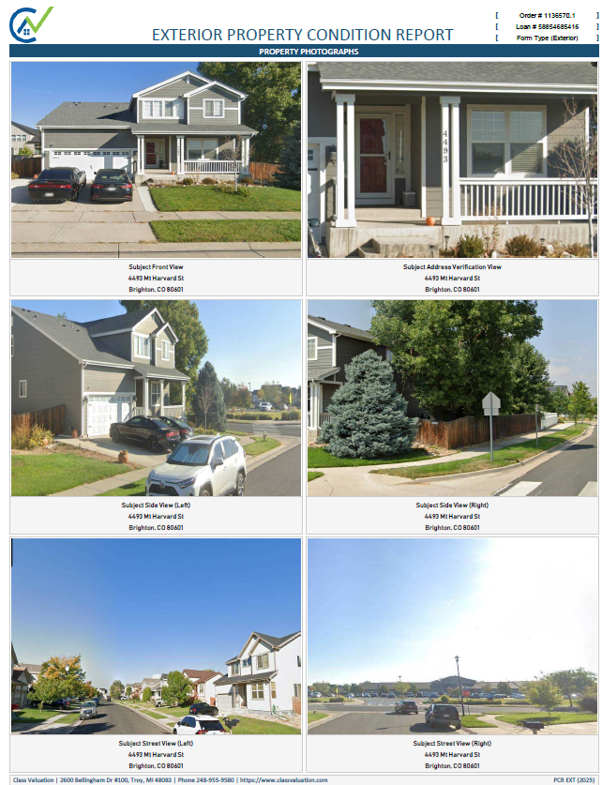
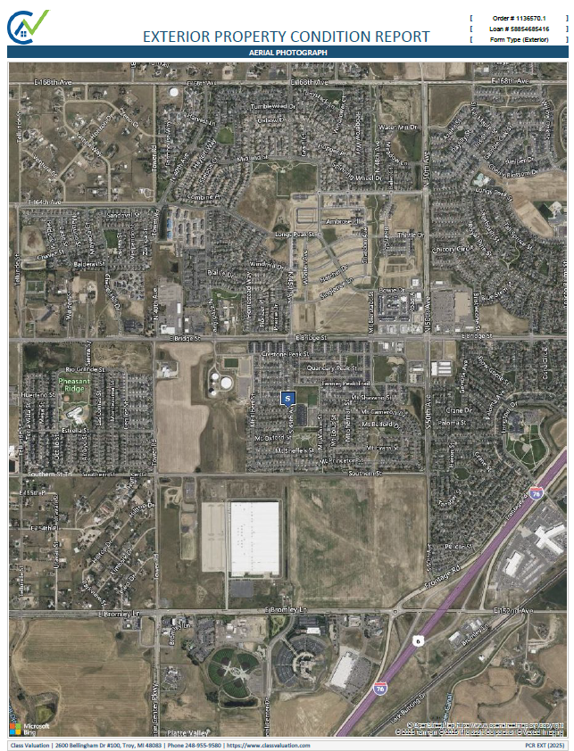
PCR Example

Slide 13
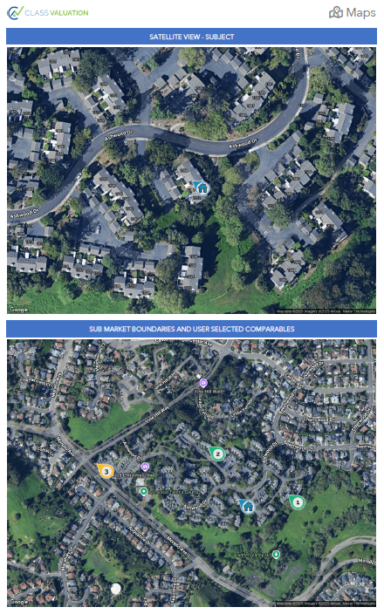
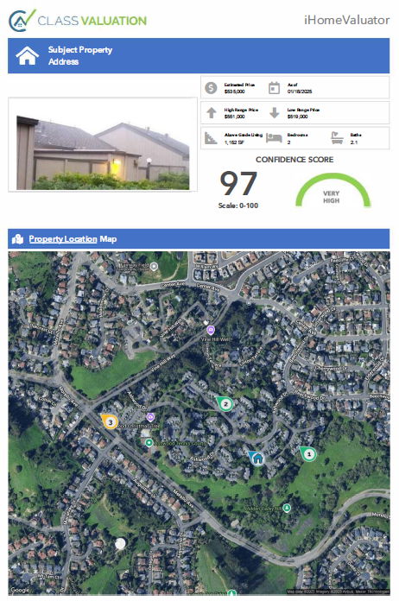
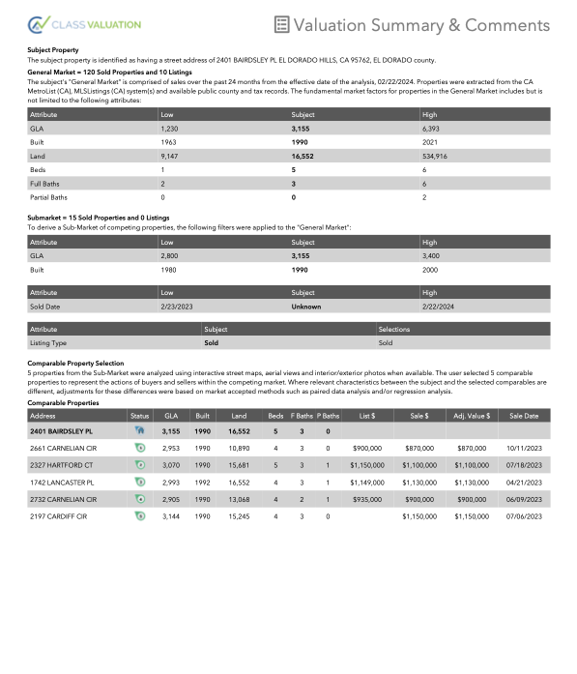
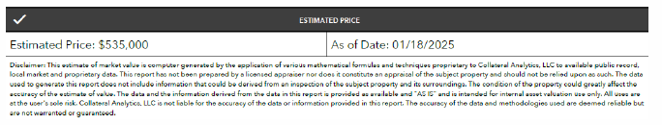
Limited Class Evaluation

Slide 14
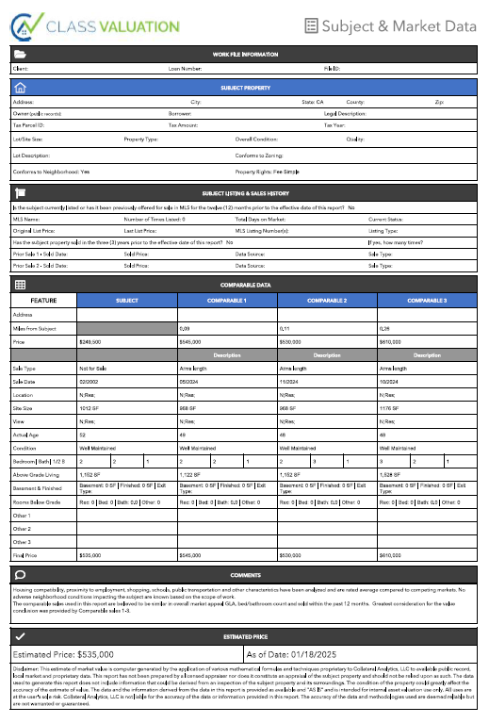
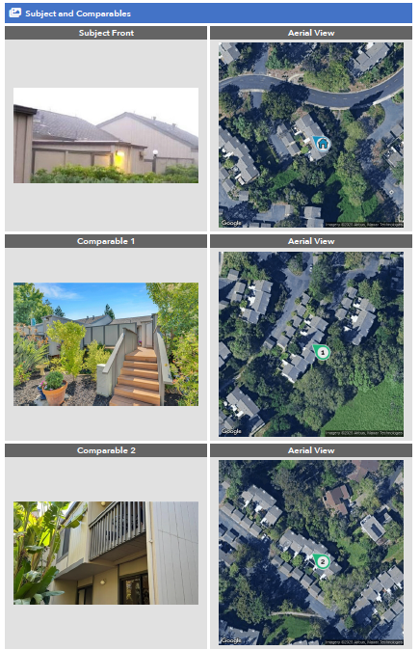
Class Evaluation

Slide 15
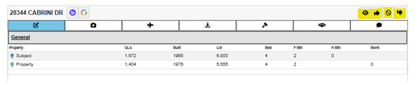
Class Evaluation Process
Combination review of AVM + Appraiser assisted review of data to increase confidence score of AVM
Value should ALWAYS be within the range of the sales chosen
Value conclusion is based on similarities/differences of all comps selected
  Algorithm compares subject property to the comparable property’s characteristics
  Takes into consideration when sales are viewed but not added to the grid
Appraiser is expected to review comps and provide a “thumbs up or thumbs down” within the evaluation tool as well as a reason for why a comp is inferior/superior

Slide 16
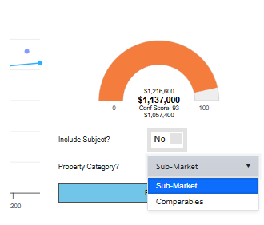
Class Evaluation Process
If an opinion of value is ever derived and it is not within the range of sales, it could be because all sales are inferior or superior to the subject property
  This should only really occur when a property is on large acreage, when the analyst reveals these results, they should stop work and contact Class Valuation and not proceed with the report, it will not increase the confidence score and therefore makes the product obsolete.
  The analyst also may not have changed the regression analysis tool from “Sub-Market” to “Comparables”

Slide 17
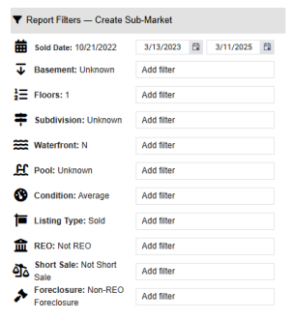
Class Evaluation Process
  The system defaults to “Sub-Market,” if this is not updated to “Comparables” the and sales in the “data” tab of the tool, and it could produce an invalid opinion of value.
  Comp filters also much be reviewed to avoid using comps older than 12 months, the analyst must adjust this manually on all reports prior to determining their comp selection
  Filters for the graph analysis are also controlled by the analyst to close the gap on the data shown within the report, our main analyst starts with +/-25% GLA within 25% of the subject’s lot size and brackets the bedroom and bathroom count.

Slide 18
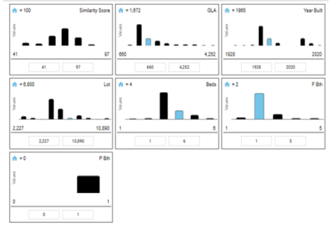
Class Evaluation Process
  Lastly, the analyst will review all sales within the ranges based on how they’ve filtered the report tool and view comparable photos to see if comps have been renovated, have similar features (pools, spas, garages, style, etc.) based on this review, the best 3-5 sales within the 12-month period are chosen.
  The analyst do their best to produce a >90 confidence score, they’ll start with 3 comps, and if the confidence score is not 90 or above, they will add 2 additional sales to increase the confidence score within the report.

Slide 19
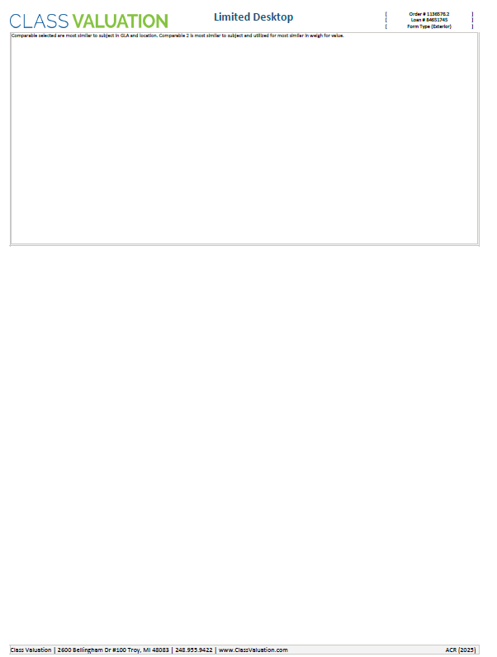
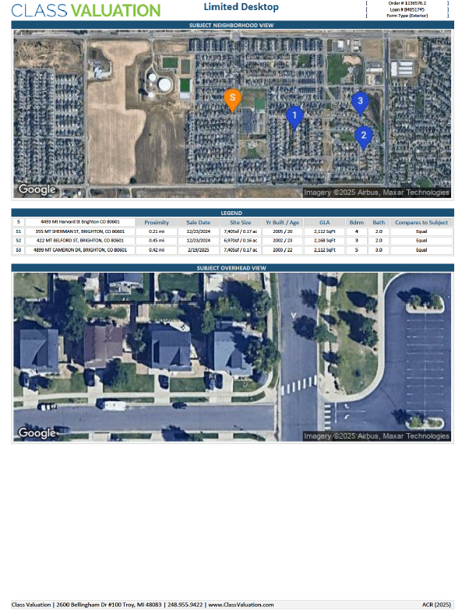
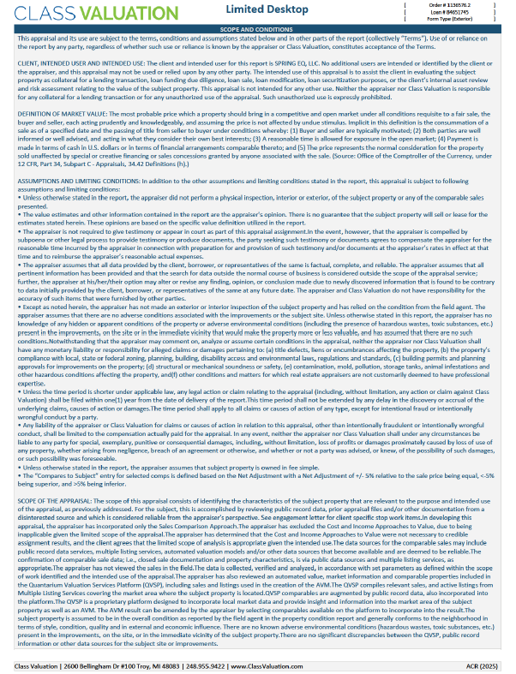
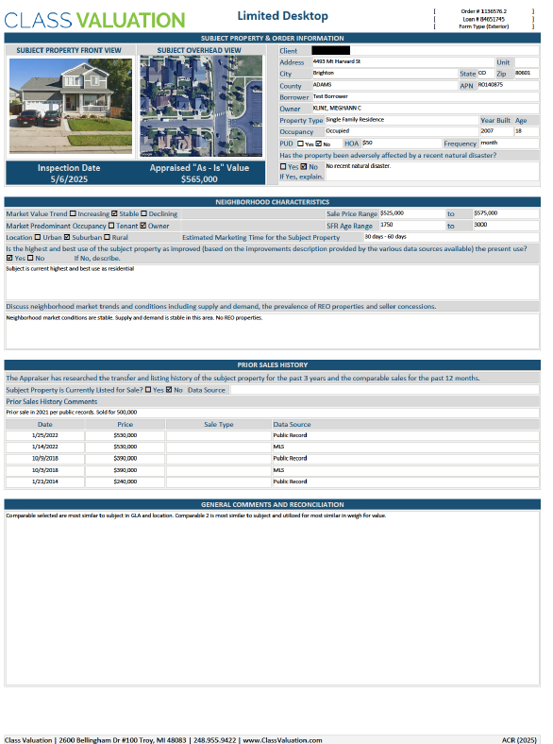
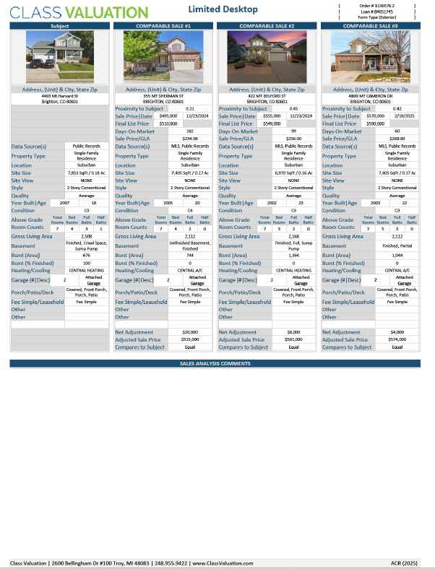
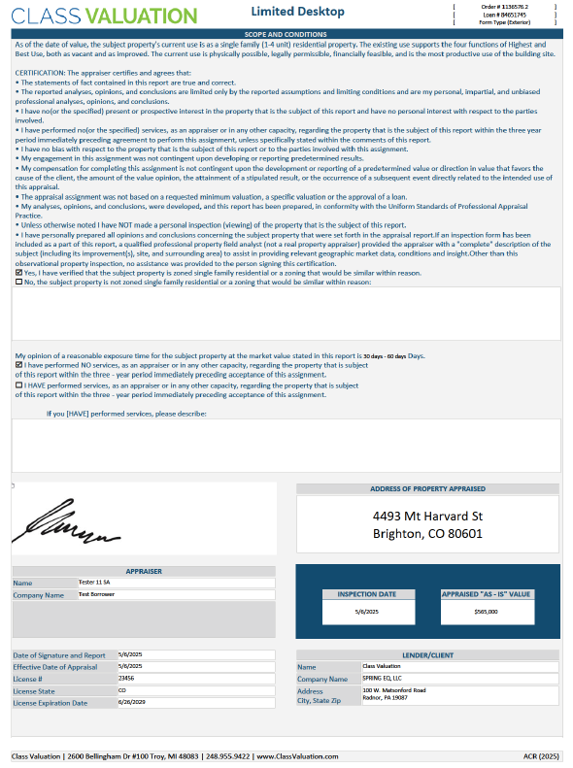
Limited Desktop Example

